Slide 1
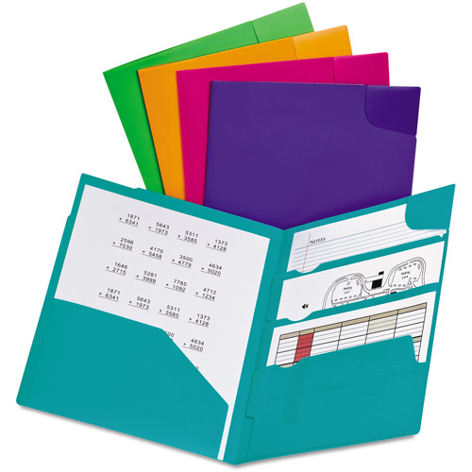
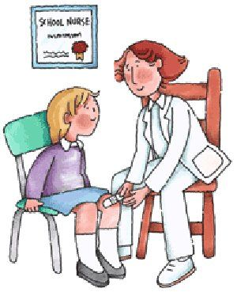
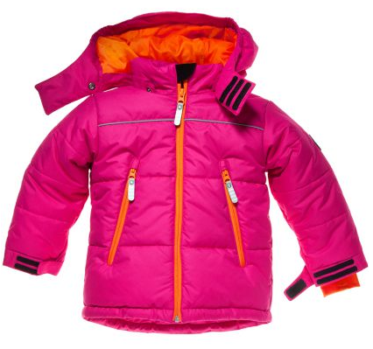
Door Reminders:
When you arrive...
Before you leave...
Backpack | Folder | Homework
Car | Bus | Nurse
Coat | Hat | Gloves
Bathroom | Water | Lunch

