Slide 1
I See Fall
Read by:

Slide 2
I see leaves.

Slide 3
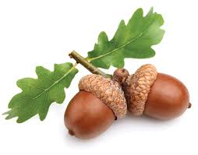
I see acorns.

Slide 4
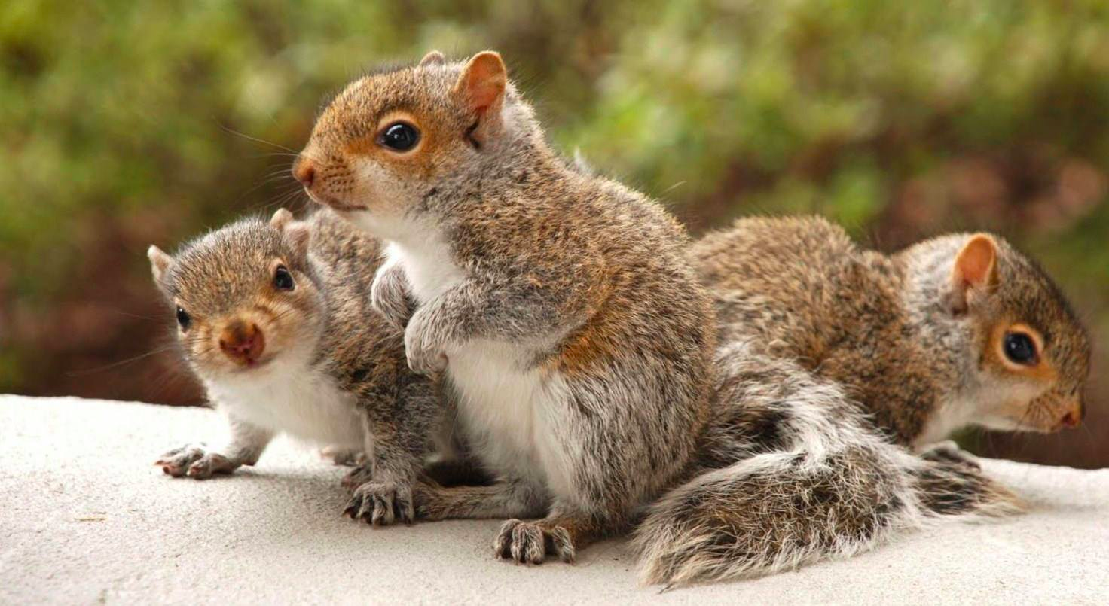
I see squirrels.

Slide 5
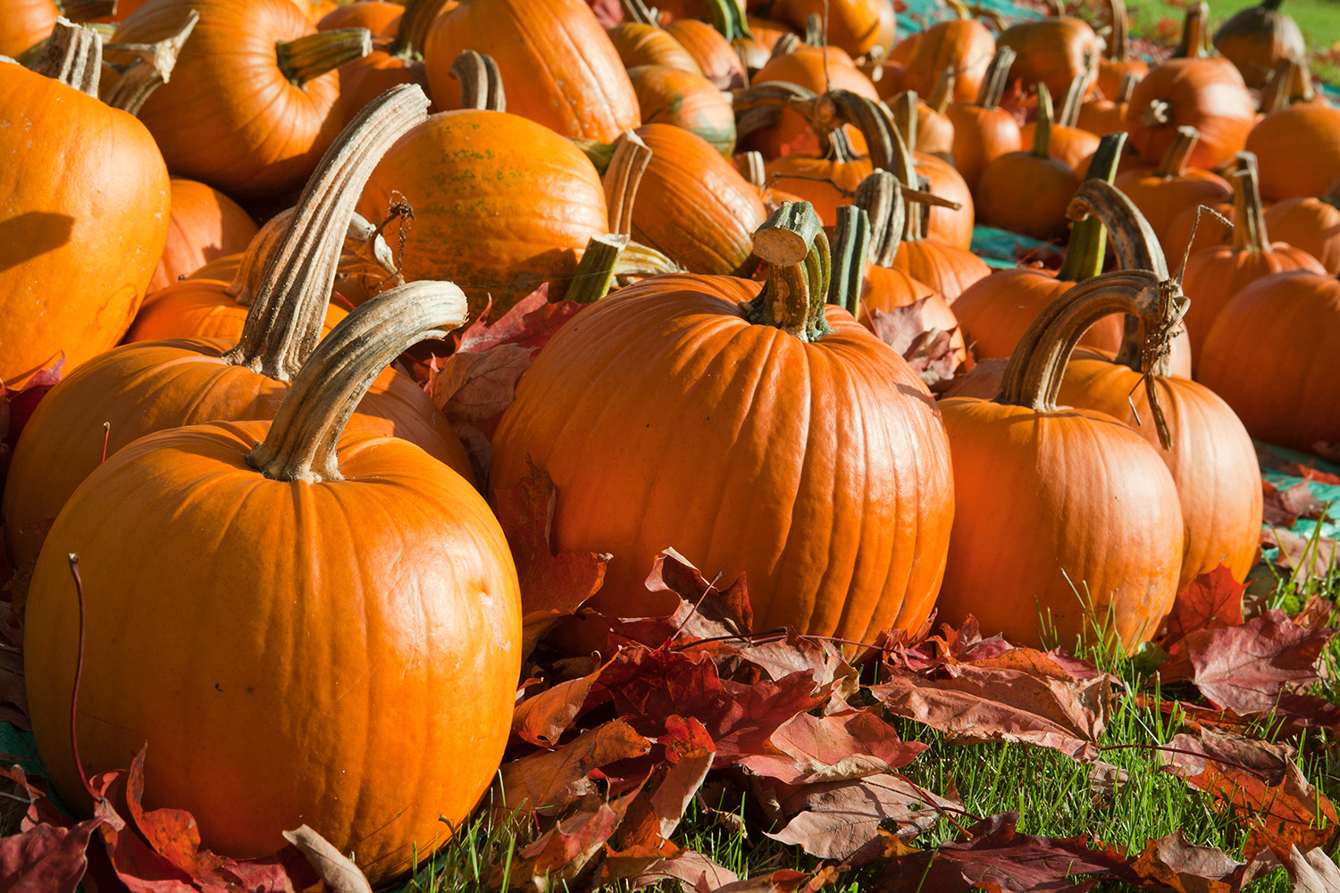
I see pumpkins.

Slide 6
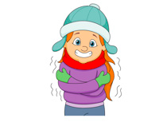
I feel chilly.

Slide 7
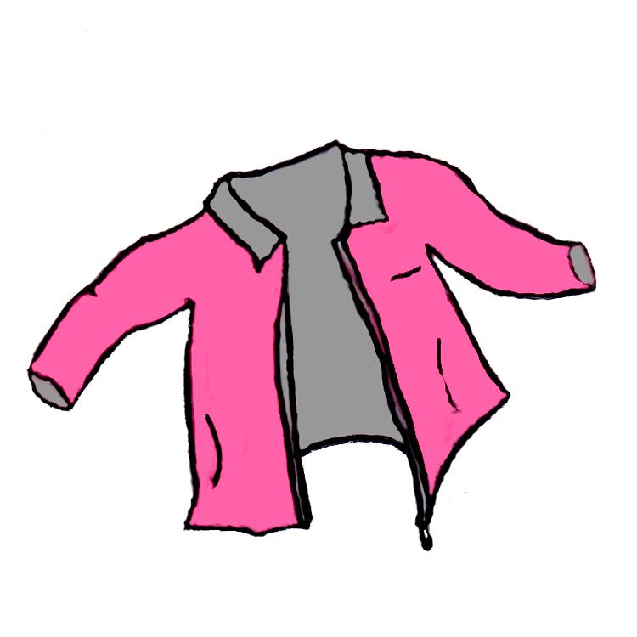
I wear a jacket.

Slide 8
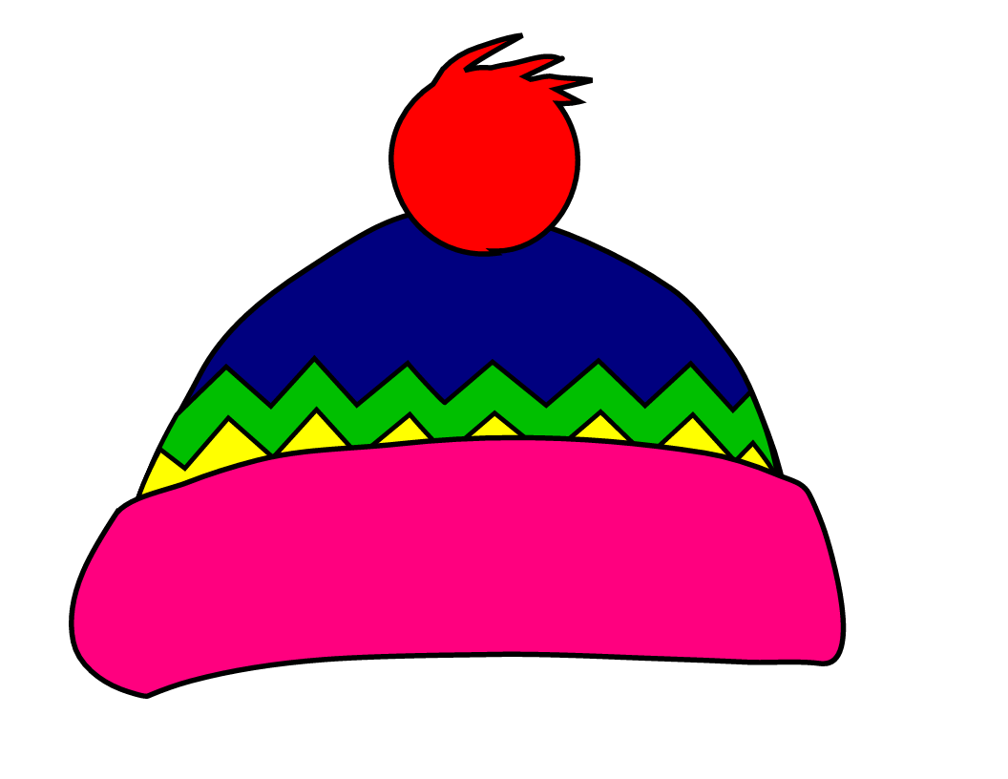
I wear a hat.

Slide 9
I wear a scarf.

Slide 10
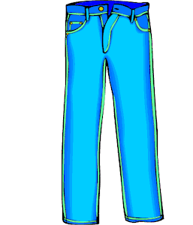
I wear pants.

Slide 11
Let’s draw and write together!
I see the _____.
__ ____ ____ _____.

Slide 12
Let’s draw and write together!
I see the _____.
__ ____ ____ _____.

